Slide 1

Prompting

Slide 2
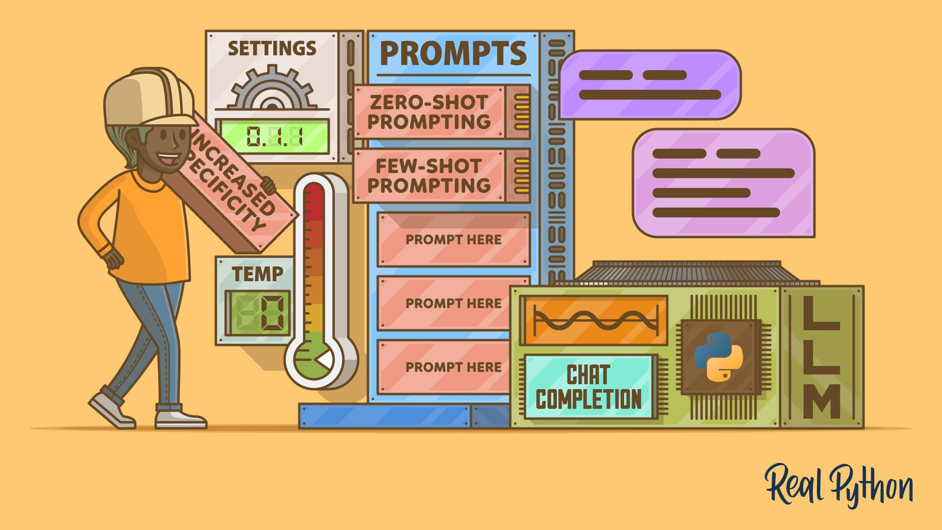
What is Prompting & Prompting design?
Prompting means giving instructions or inputs to an AI model (like ChatGPT, Gemini, or Claude) so it produces the output you want — such as text, images, code, summaries, or answers.
Prompt design means crafting your instructions or questions in a way that helps an AI model (like GPT or Gemini) give accurate, useful, and clear answers.

Slide 3
Key Principles
Principle | Explanation | Example
Clarity | Be specific about what you want. Avoid vague wording. | ❌ “Explain climate.” → ✅ “Explain how climate change affects polar regions.”
Context | Give background or data for better understanding. | “Based on this paragraph, summarize the key points in 3 bullet points.”
Structure | Use formatting, lists, or step-by-step requests. | “Summarize in 3 points: 1) cause, 2) effect, 3) solution.”
Role assignment | Tell the model who it should act as. | “Act as a data analyst and explain the chart.”
Constraints | Set limits for the answer (words, tone, etc.). | “Explain in under 50 words using simple language.”

Slide 4
Types of Prompting
Type | Description
Zero-shot | No examples, just instruction.
Few-shot | A few examples included in the prompt.
Chain-of-thought | Asking the model to reason step-by-step.
Instruction-based | Clear tasks like “Summarize,” “Explain,” “Translate.”

Slide 5
In-Context Learning
Large Language Models (LLMs) do not “learn” in the traditional sense during inference.
Instead, they adapt to patterns given in the prompt itself.
This ability to condition their behavior on a few examples provided at runtime is called In-Context Learning (ICL).

Slide 6
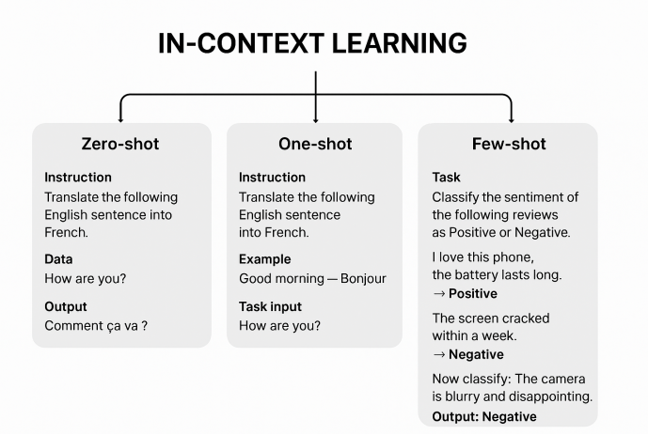

Slide 7
Zero & Few-shot Prompting
Type | Meaning | Example
Zero-shot prompting | You give no examples, just instructions. | 🟢 “Translate this sentence to French: ‘Good morning.’”
Few-shot prompting | You give a few examples to show the pattern. | 🟡 “Translate the following sentences to French: Hello → Bonjour Thank you → Merci Good morning → (model predicts) Bonjour.”
Few-shot prompting helps the model learn the pattern from examples, improving accuracy for complex tasks

Slide 8
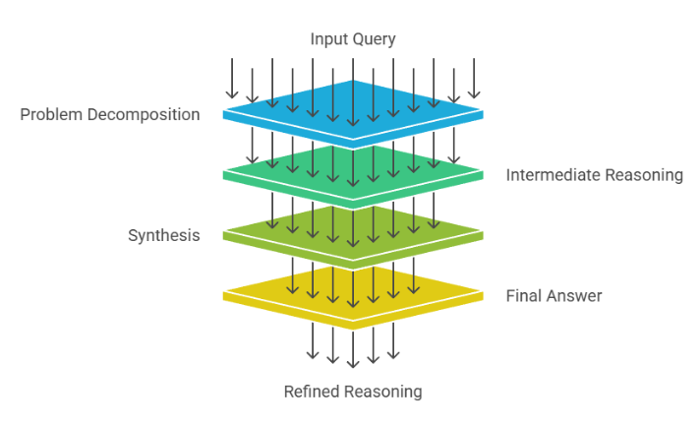
Chain-of-Thought Reasoning
Chain-of-thought (CoT) means asking the model to “think aloud” by reasoning step-by-step before giving the final answer.
Without CoT:
Q: If I have 3 apples and eat 1, how many are left? A: 2
With CoT:
Q: If I have 3 apples and eat 1, how many are left? Think step-by-step. A: I start with 3 apples. I eat 1, so 3 - 1 = 2 apples left.

Slide 9
Chain-of-Thought Reasoning
Why use CoT: ✅ Better logical reasoning ✅ Improved math, code, and decision-making tasks ✅ Easier debugging of mistakes
💡 You can encourage CoT by adding phrases like “Think step-by-step” or “Explain your reasoning.”

Slide 10
Instruction-Based Prompting
Instruction-based prompting means telling the AI model exactly what to do using clear, direct commands in natural language.
It focuses on explicit instructions, not just questions or examples.
⚙️ Structure of an Instruction-Based Prompt
A good instruction prompt often includes:
🎯 Task → What should the model do? “Summarize,” “Translate,” “Explain,” “List,” “Classify,” etc.
📄 Input → What should it work on? “Summarize the following paragraph…”
🧱 Constraints / Format → How should the output look? “Use 3 bullet points,” “In one sentence,” “In JSON format,” etc.

Slide 11
Importance of prompting
1. Improves Accuracy 🎯
A good prompt reduces ambiguity and helps the model give correct and relevant answers.
2. Controls Output Format 🧩
Prompting tells the model how to respond (list, paragraph, table, code, etc.).
3. Saves Time ⏱️
Clear prompts reduce back-and-forth corrections and give usable results in one go.
4. Provides Context 🧠
Adding background information helps the model respond more intelligently.
5. Guides Model Behaviour 🤖
Prompts can define tone, level, and role.

